Slide 1


Octantis’ Sustainable Growth - T800
Jason Huang, Xinran Li, Kyle Wang, Fan Zhang, Shengkang Zhou
March, 2022

Slide 2






Team (E)
Xinran (Ivy) Li
Quantitative Methods for the Social Sciences, DS track
xl3110@columbia.edu
Fan Zhang
Business Analytics and Information Management
fanfan@udel.edu
Jason Huang
Applied Analytics
yh3439@columbia.edu
Kyle Wang
Bioinformatics and Data Science
kylewang@udel.edu
Shengkang (Tobias) Zhou
Quantitative Methods for the Social Sciences, DS track
sz3002@columbia.edu

Slide 3
Driving Good Growth in 2020
Objectives
Sustainable growth: optimizing media levers to maximize sales
Data
Historical SUV T800’s media related data (2018-19)
KPI
Increase month-to-month Sales Unit while maintaining a low media expense

Slide 4
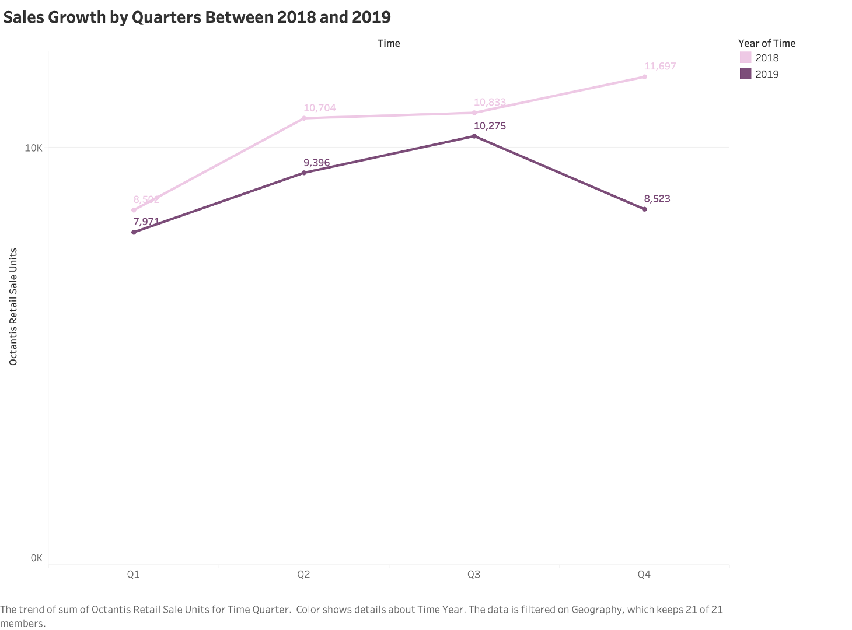
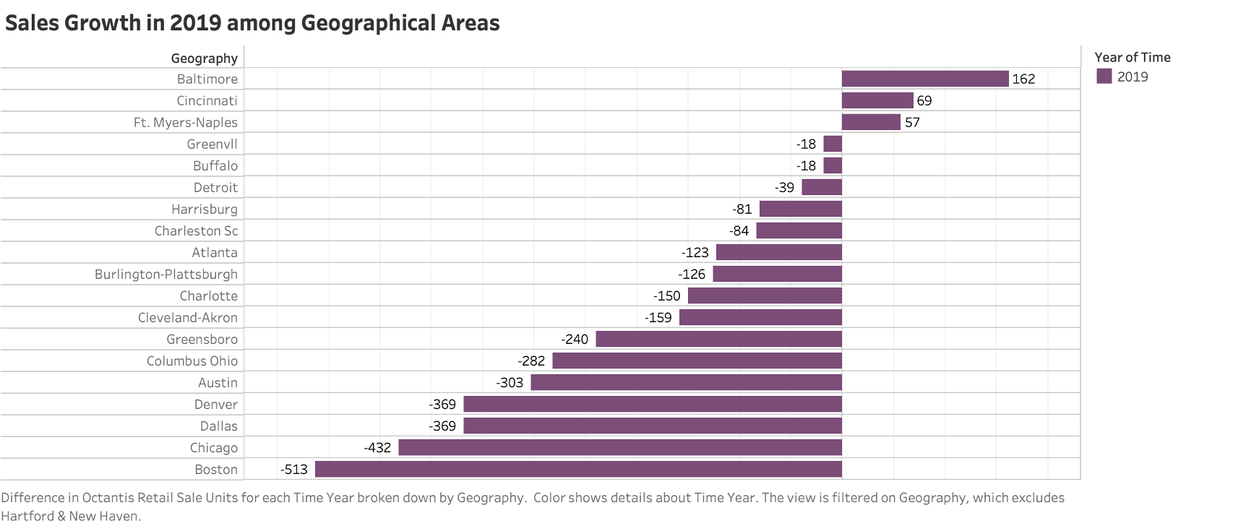
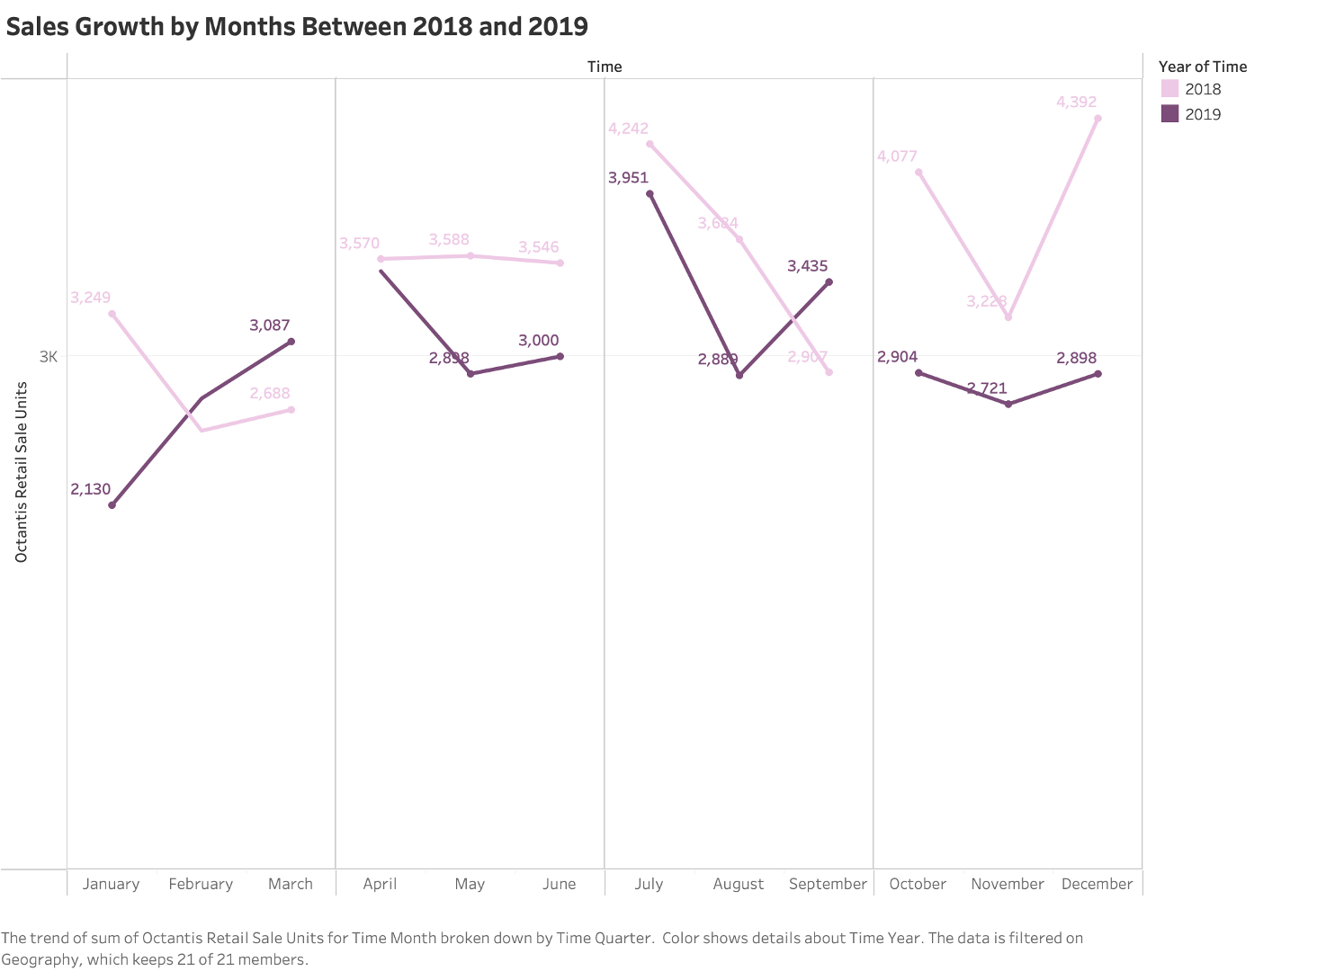
Exploratory Data Analysis
From our first-hand exploration, the retail sales units of SUV T800 had been decreasing by yearly compared the previous year
Taking a closer look, 9 out 12 months in 2019 failed to surpass previous year's sales amount.
However, interesting insight was found - three geographical areas have positive growth on sales compared to their 2018 sales
EDA
TOP FACTORS
OPTIMIZATION
FORECASTING
IMPROVE

Slide 5
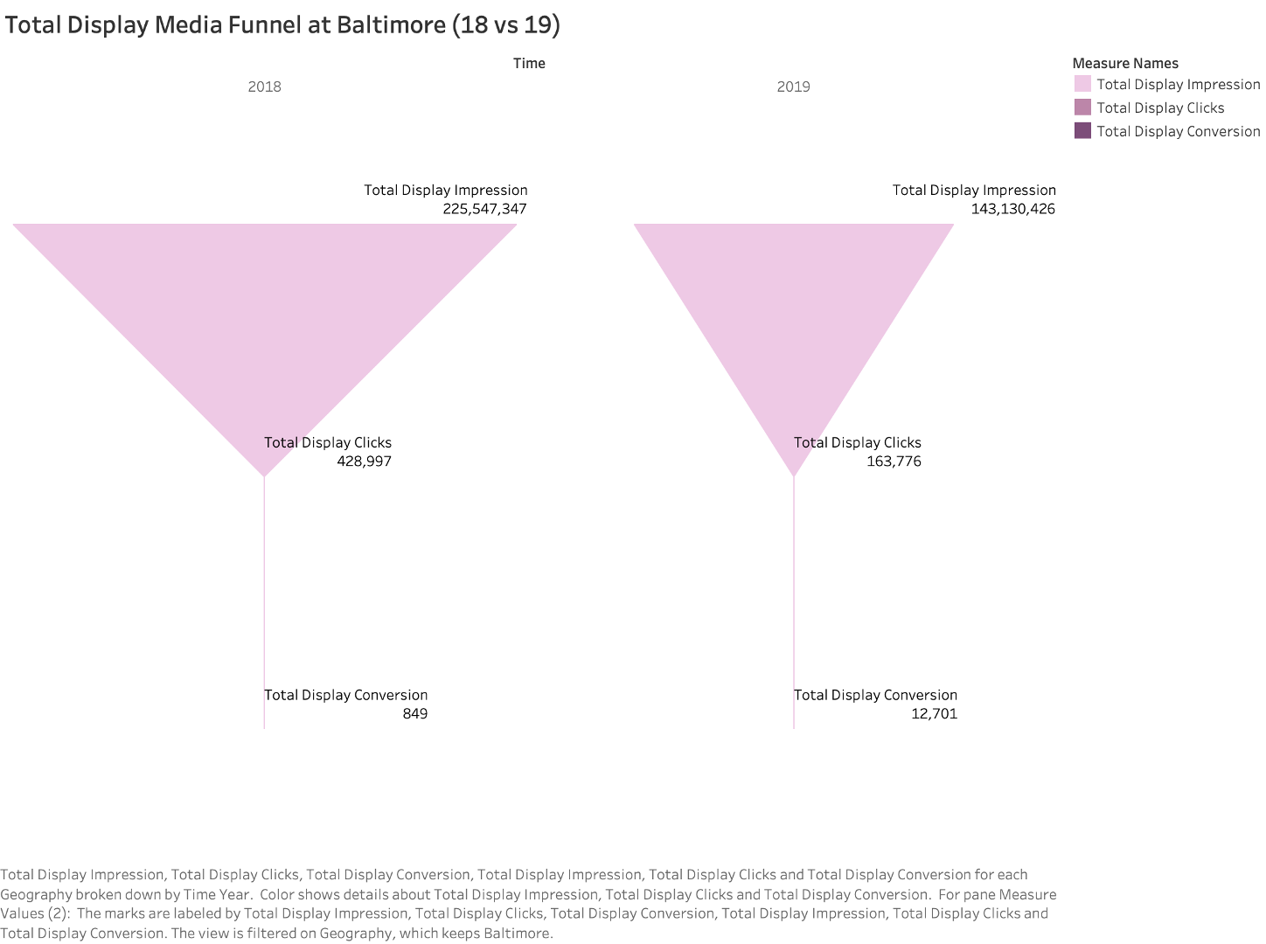
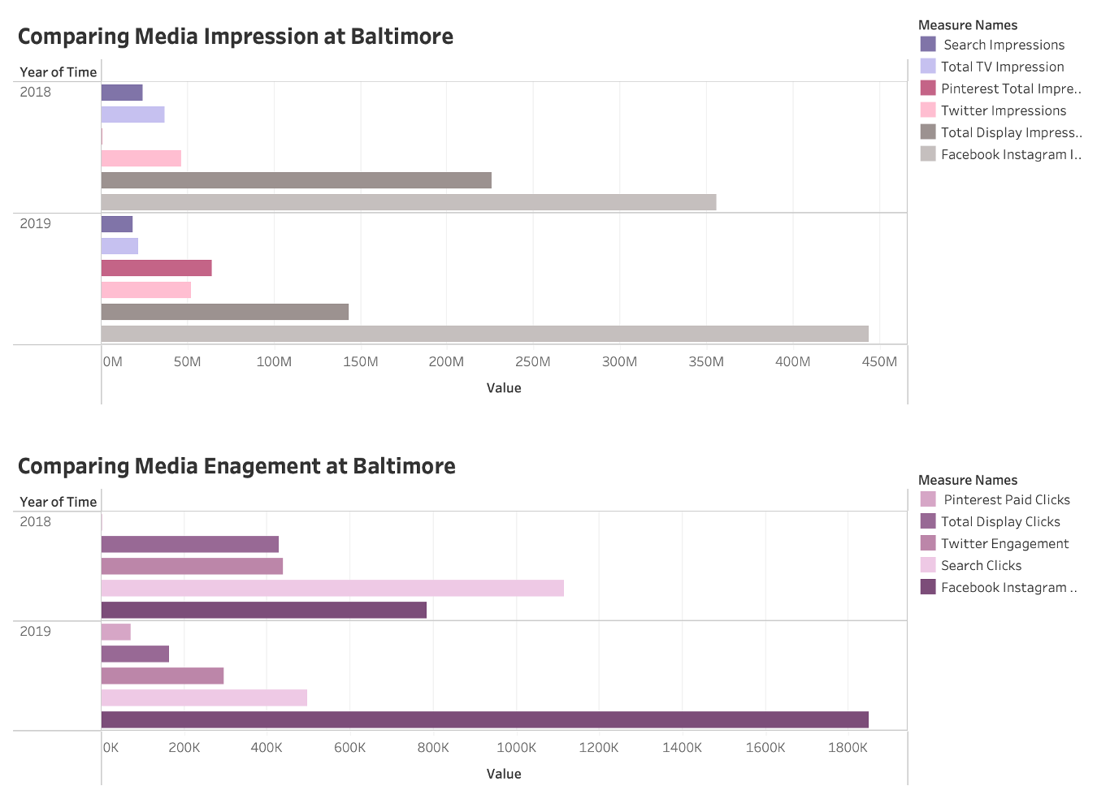
Exploratory Data Analysis - Baltimore Area
225,547,347
143,130,426
*135% growth*
849
12,701
Around 25% more impressions were received among Facebook & Instagram, which lead to over 135% engagement growth from Facebook & Instagram.
New impressions/engagements gained from Pinterest compared to year of 2018
Display Media conversion rate improved from 2018 based on the media funnel
EDA
TOP FACTORS
OPTIMIZATION
FORECASTING
IMPROVE

Slide 6
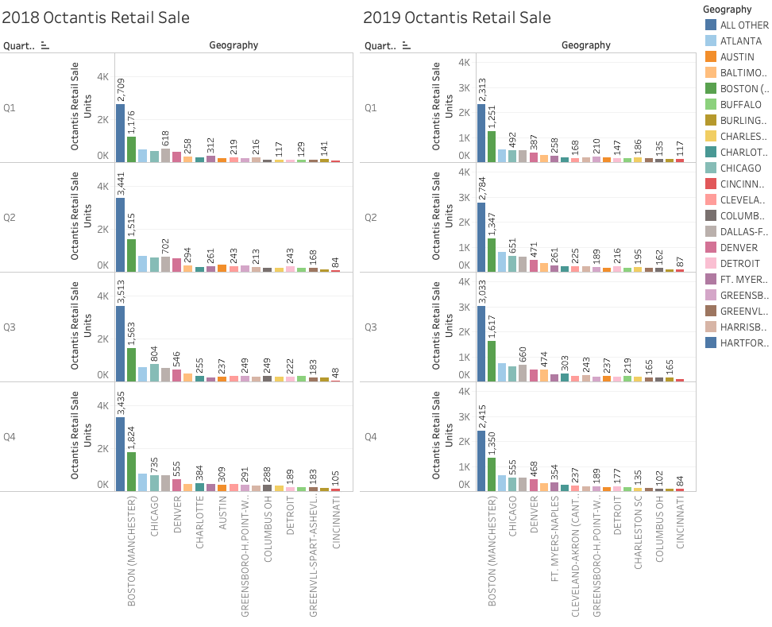
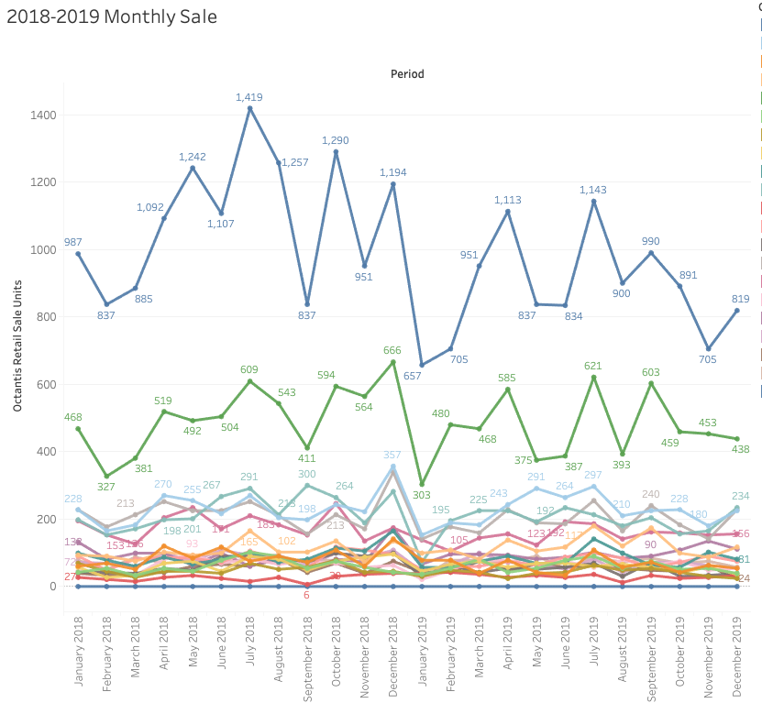
Exploratory Data Analysis
2018 Grand total sale unit 41,736
2019 Grand total sale unit 36,165
EDA
TOP FACTORS
OPTIMIZATION
FORECASTING
IMPROVE

Slide 7
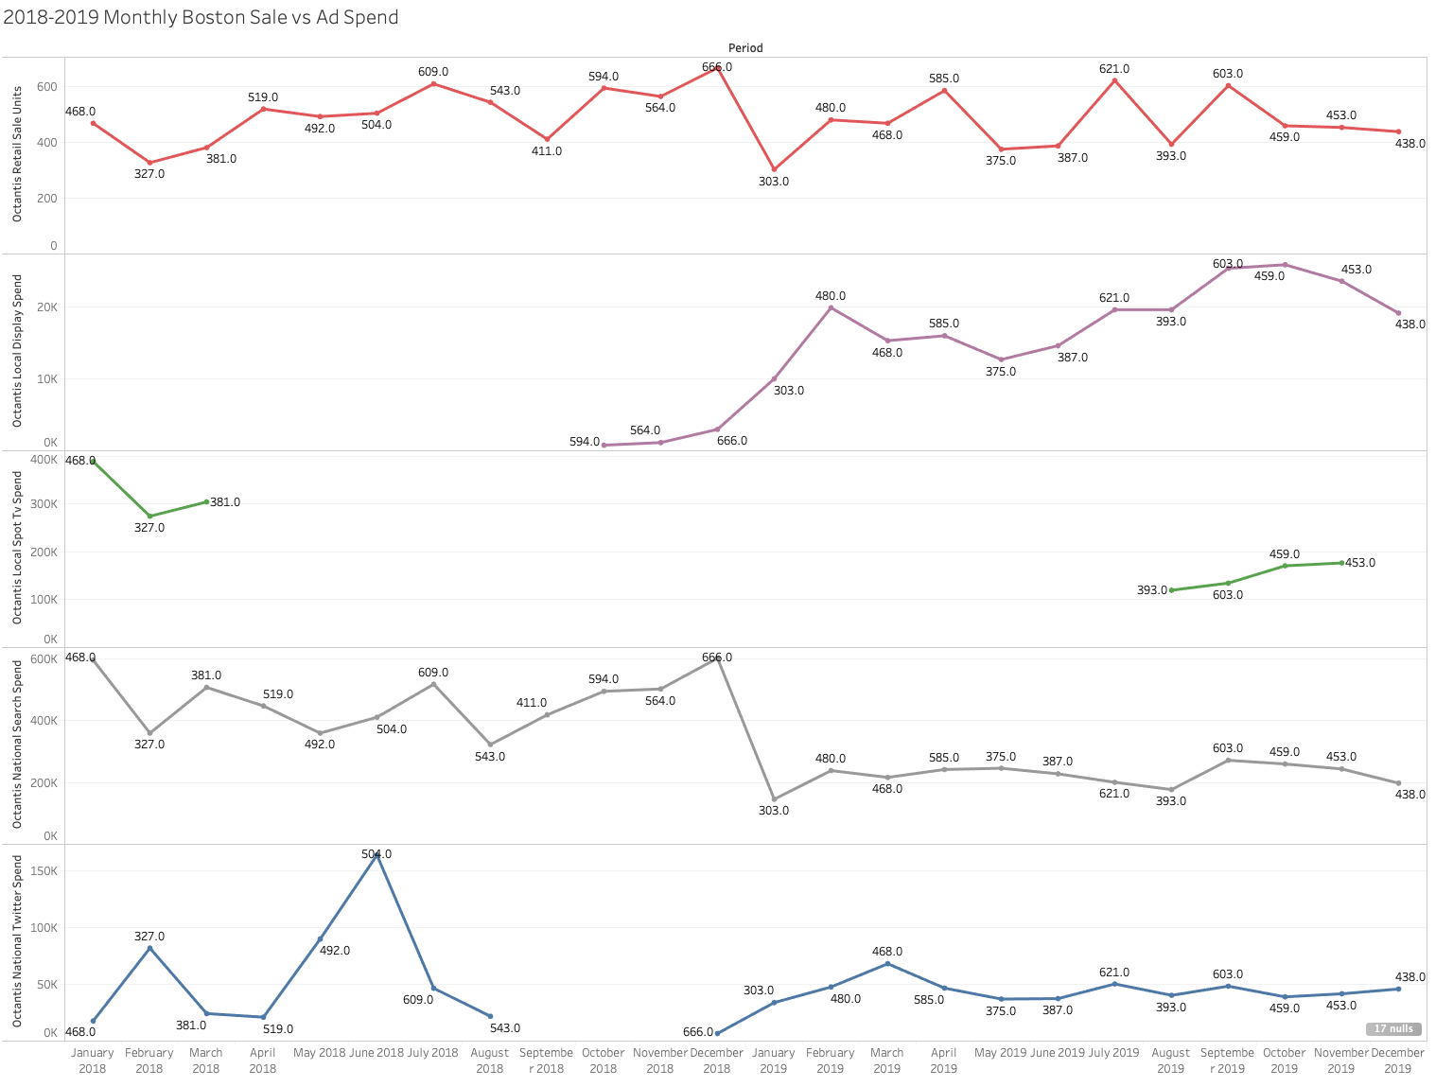
Exploratory Data Analysis - Boston
Exploratory Data Analysis
← Sales Units
*sparse*
EDA
TOP FACTORS
OPTIMIZATION
FORECASTING
IMPROVE

Slide 8
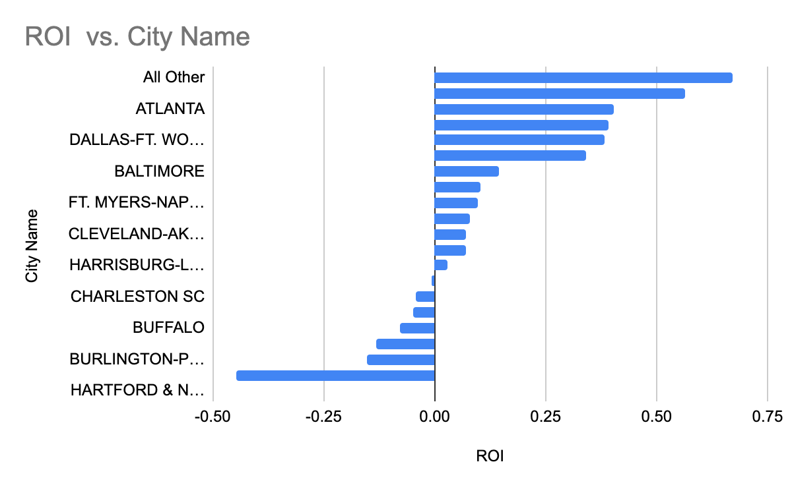
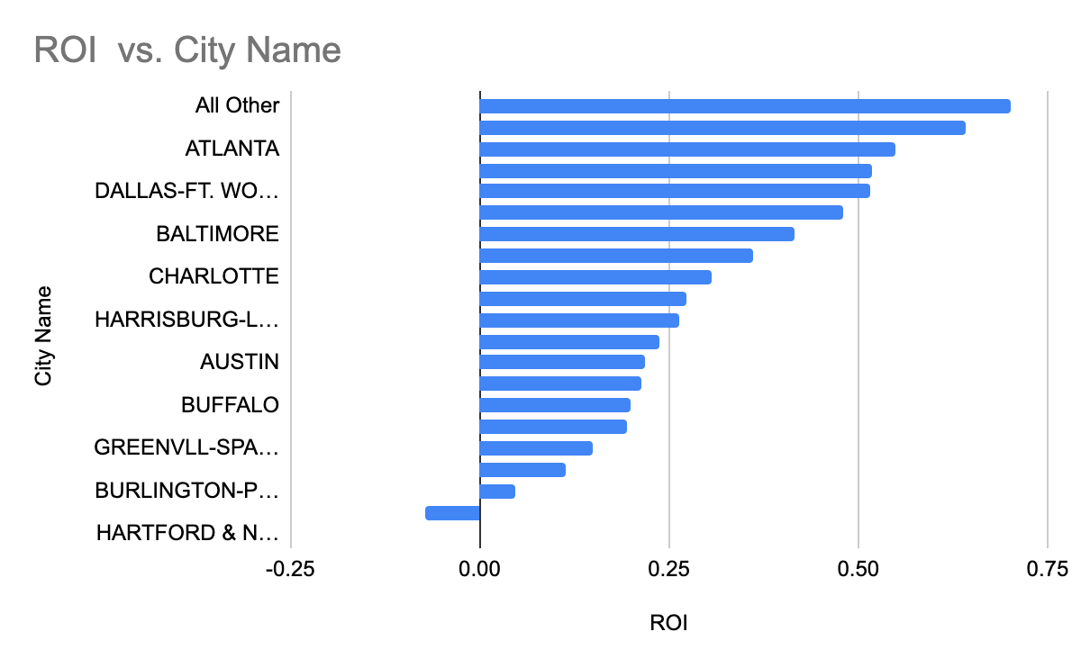
Exploratory Data Analysis - ROI 2018 vs 2019
2018 Product Unit Price:$72,280
2018 Product Unit Cost:$41,199
2019 Assume Product Price: $74,332
2019 Assume Product Cost: $42,369
EDA
TOP FACTORS
OPTIMIZATION
FORECASTING
IMPROVE

Slide 9
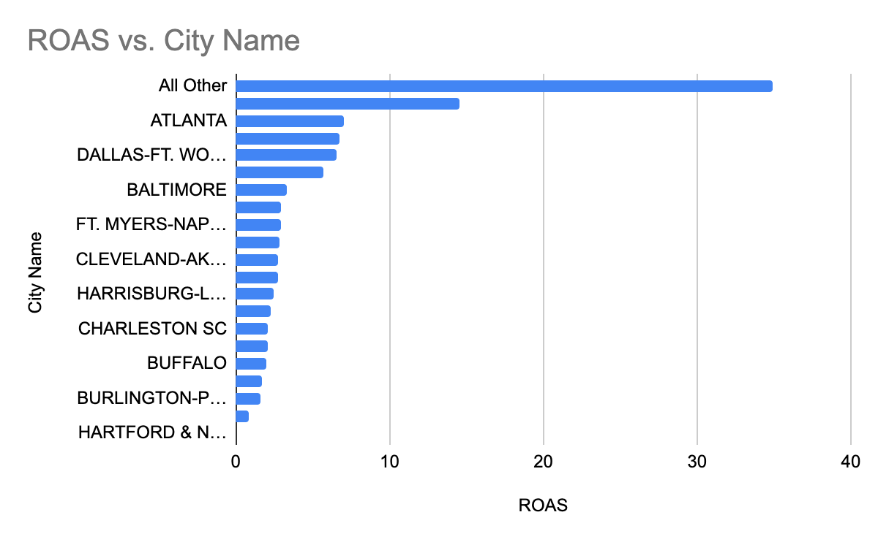
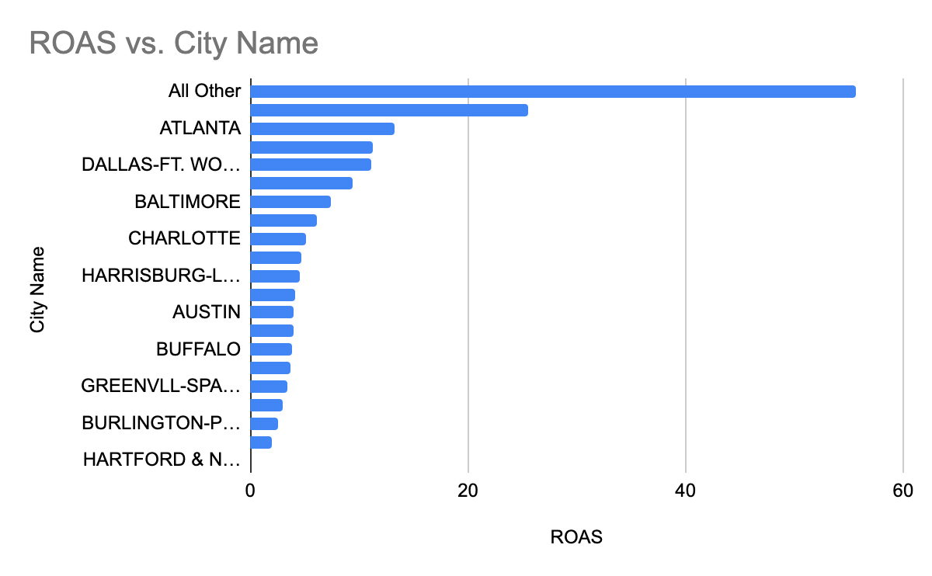
Exploratory Data Analysis - ROAS 2018 vs 2019
2018 Assume Product Price:$72,280
2018 Assume Product Cost:$41,199
2019 Assume Product Price: $74,332
2019 Assume Product Cost: $42,369
EDA
TOP FACTORS
OPTIMIZATION
FORECASTING
IMPROVE
Notes:
Return on advertising spend

Slide 10
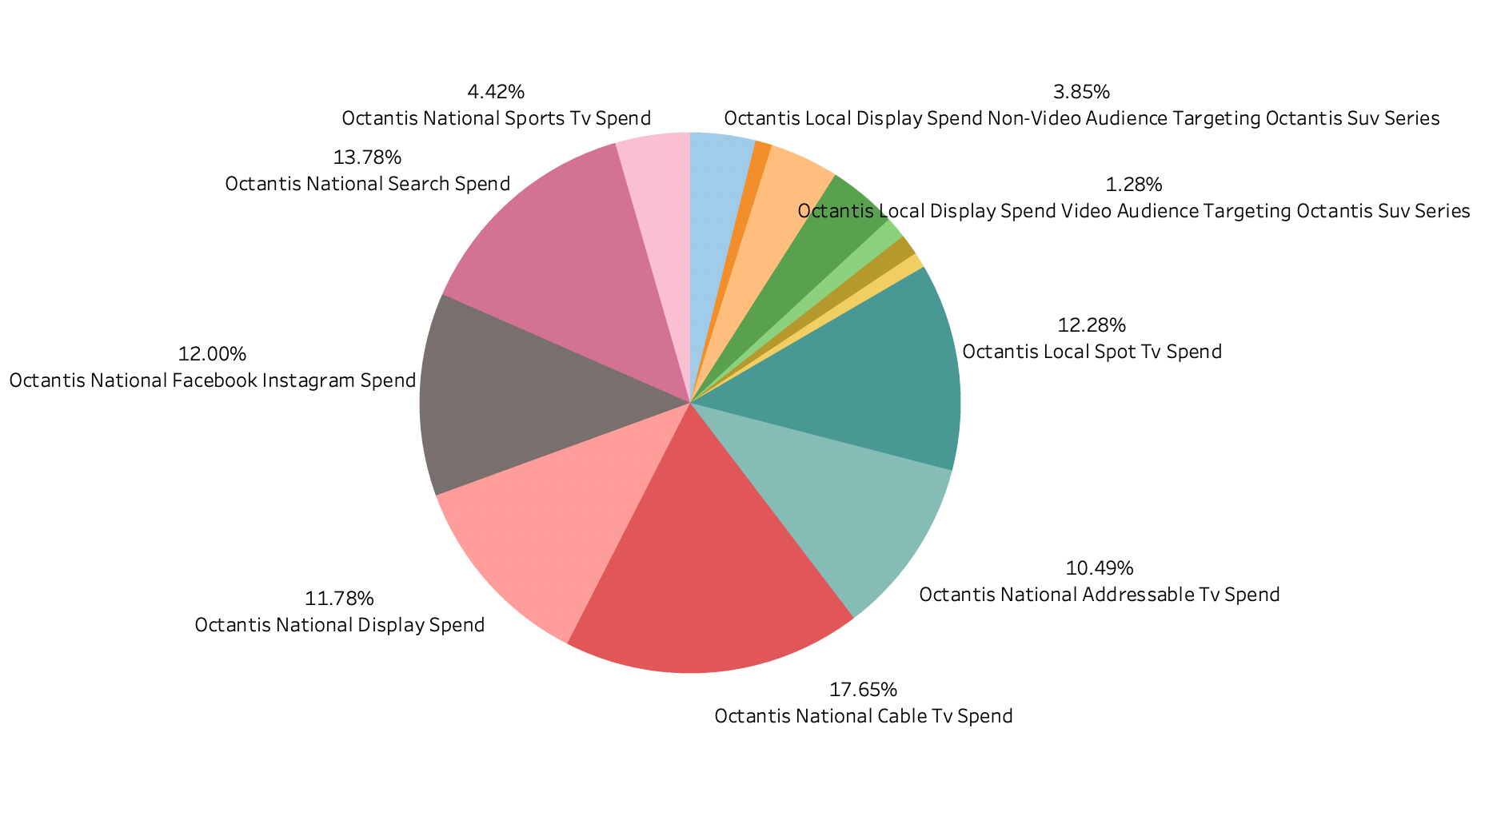
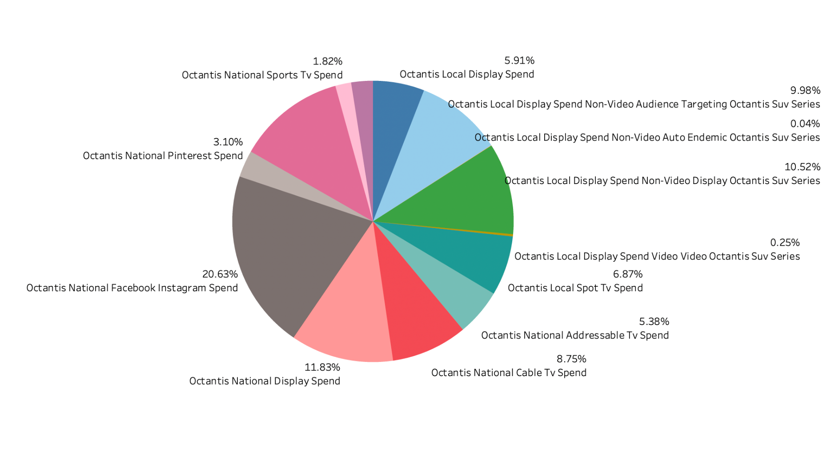
Exploratory Data Analysis - % Spend in Media Type
2018
2019
EDA
TOP FACTORS
OPTIMIZATION
FORECASTING
IMPROVE

Slide 11
“What are the top factors affecting unit sales?”

Slide 12









Top factors influencing unit sales – feature selection
Final 14 features
search_imp | search_spd
search_click | online_imp
online_spd | online_click
local_dis_imp | local_dis_spd
local_dis_click | national_dis_imp
national_dis_spd | national_dis_click
National_tv_ impression | national_tv_spend
Spend
Local
Display
Online
Imp
National
Search
TV
Clicks
Location
Type
Channel
Parameters
EDA
TOP FACTORS
OPTIMIZATION
FORECASTING
IMPROVE

Slide 13
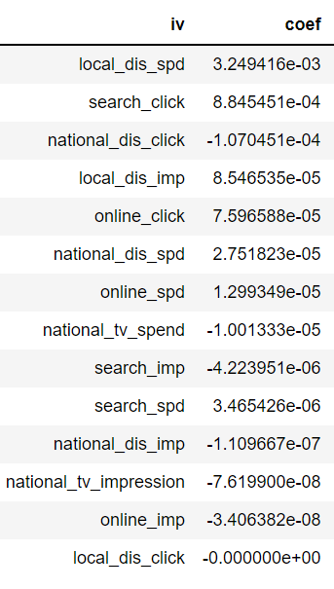
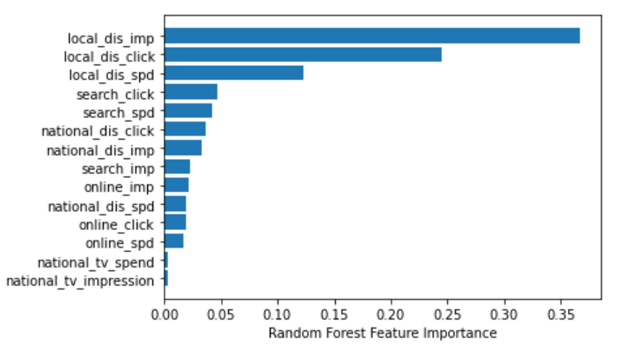
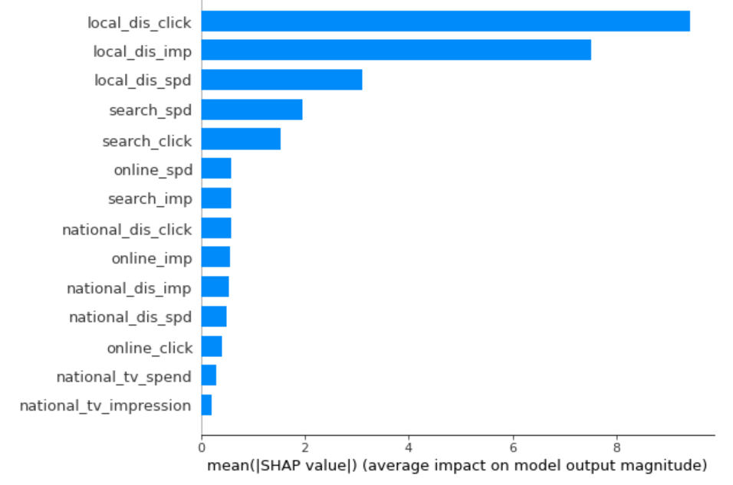
Top factors influencing unit sales – model comparison
Lasso Regression
Random Forest
SHAP
SHAP and RF agree that local display are the most important features
Followed by search advertisements
National level campaigns are less effective than local level campaigns
Channel-wise, online performs better than TV, but it still has room for improvement
EDA
TOP FACTORS
OPTIMIZATION
FORECASTING
IMPROVE

Slide 14
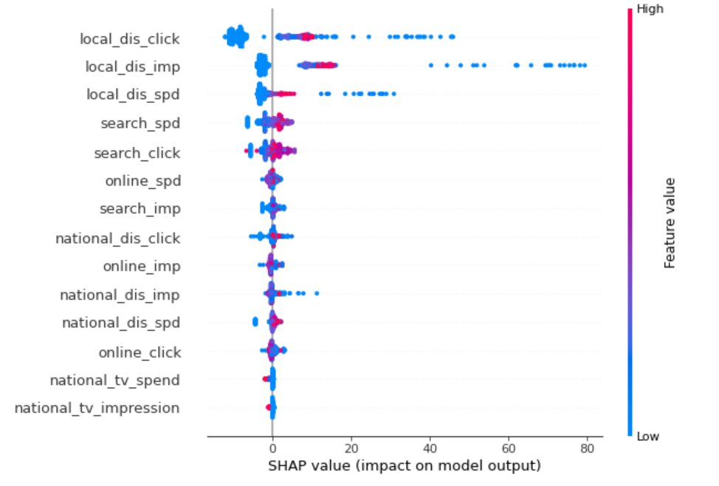
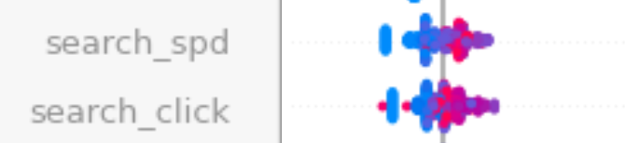
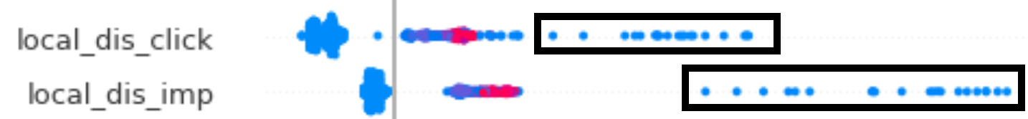
Top factors influencing unit sales – insight derived…
The relationship between local display and unit sales is not linear, indicating certain display strategies is extremely effective.
Search is positively correlated with unite sales–raise brand awareness to push search’s impact.
EDA
TOP FACTORS
OPTIMIZATION
FORECASTING
IMPROVE

Slide 15
“How can we optimize the media levers even more to generate more sales while maintaining a high ROI in the upcoming 2020 year?”

Slide 16
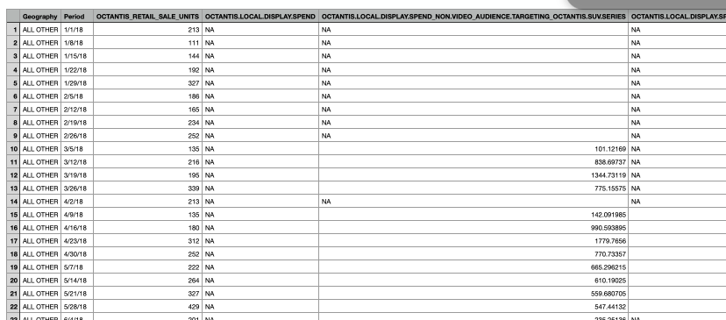
Modeling - Data
Replace NAN with 0s
Only focusing on T800
Find coefficients for each 17 independent variable for each location
Dependent variable
Multivariate Time Series
(SARIMAX/ARIMAX)
Lasso regression
Linear Programming
EDA
TOP FACTORS
OPTIMIZATION
FORECASTING
IMPROVE

Slide 17
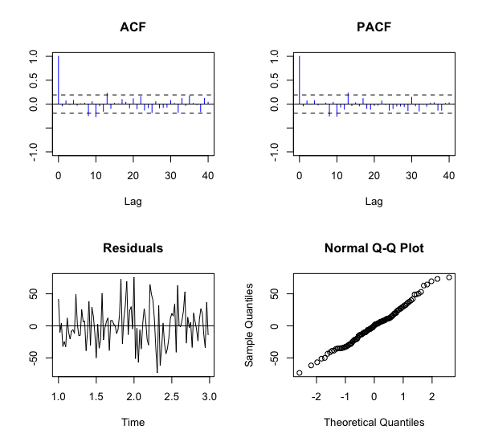
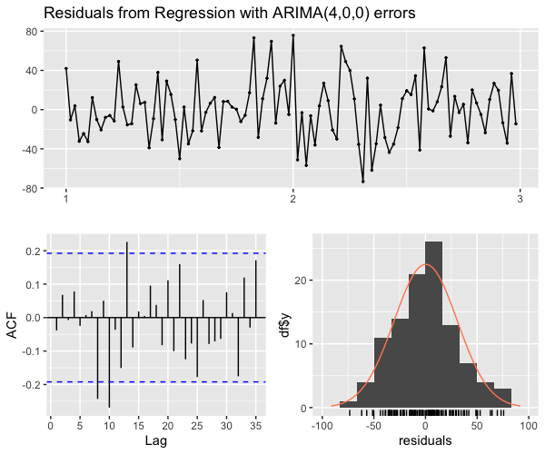
Modeling - Multivariate Time Series (ARIMAX) - Boston
AIC = 1054.669
EDA
TOP FACTORS
OPTIMIZATION
FORECASTING
IMPROVE

Slide 18
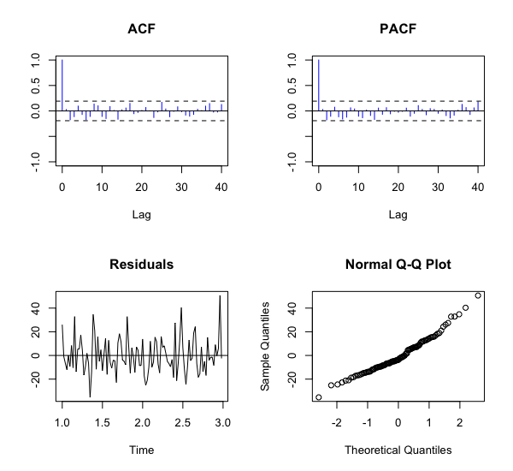
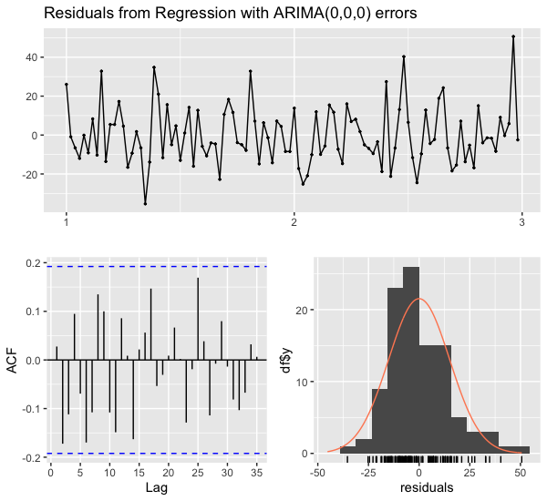
Modeling - Multivariate Time Series - Chicago
EDA
TOP FACTORS
OPTIMIZATION
FORECASTING
IMPROVE

Slide 19
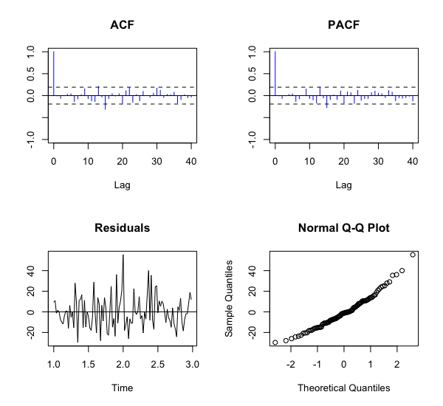
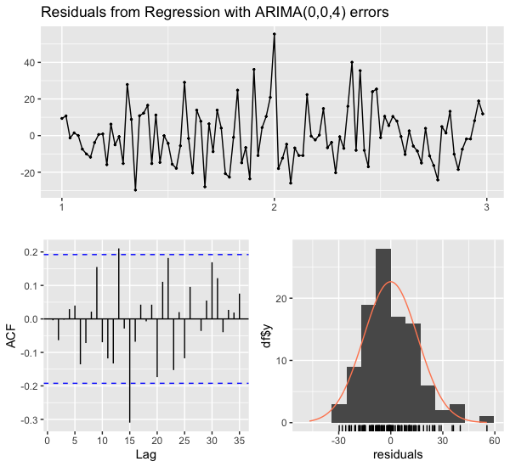
Modeling - Multivariate Time Series - Atlanta
EDA
TOP FACTORS
OPTIMIZATION
FORECASTING
IMPROVE

Slide 20
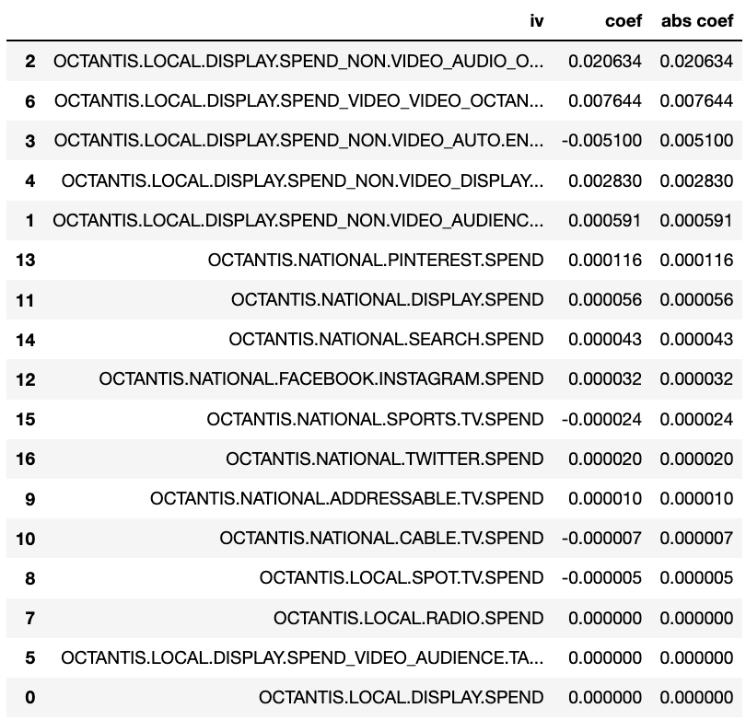
Modeling - ALL Others
Lasso Regression
EDA
TOP FACTORS
OPTIMIZATION
FORECASTING
IMPROVE

Slide 21
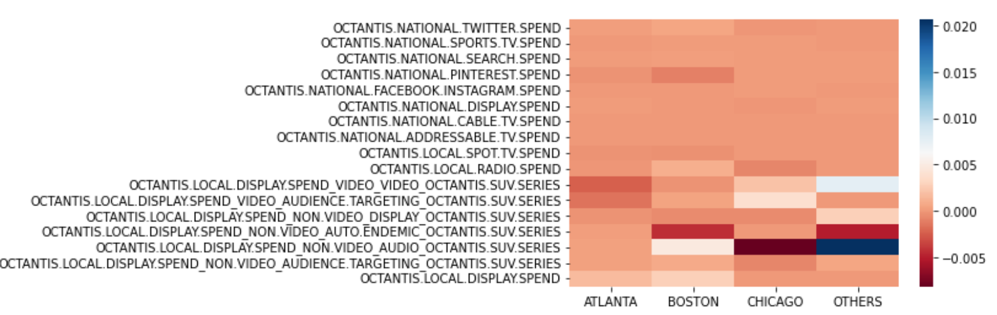
Modeling - Coefficients
EDA
TOP FACTORS
OPTIMIZATION
FORECASTING
IMPROVE

Slide 22
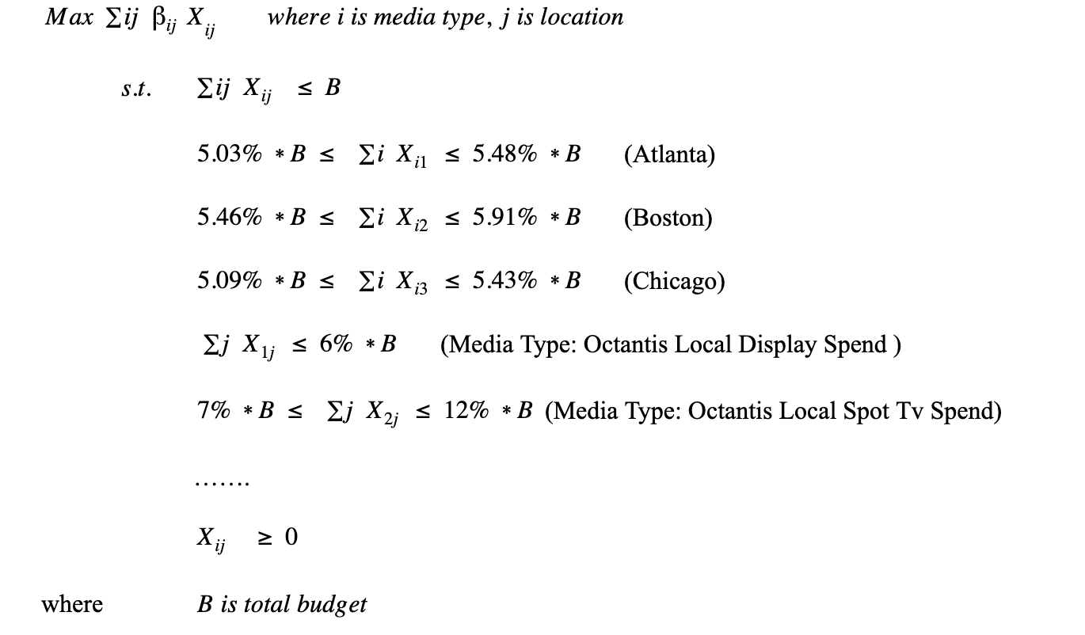
Optimization - Budget Allocation
Total Spend of 2019: ~$21.5M
68 variables
42 constraints
Linear Programming solver
Feasible solution
Optimal objective:
110, 329 units
EDA
TOP FACTORS
OPTIMIZATION
FORECASTING
IMPROVE

Slide 23
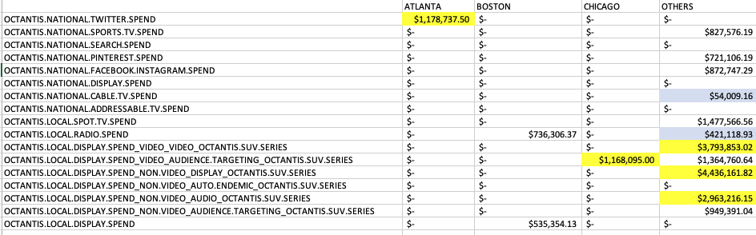
Forecasting
Hypothetically, 110, 329 units (69% increase) from 2019
EDA
TOP FACTORS
OPTIMIZATION
FORECASTING
IMPROVE

Slide 24
Conclusion - Octantis T800
Top Factors: Local Display Impression\Clicks\Spending, Search Click
Budget Allocation:
Twitter Spend - Atlanta
Local Radio/Display Spend - Boston
Local Display w/ Targeted Audience - Chicago
Local Display - Others
Forecasting: 110k Unit Sale → $8B Total Annual Rev in 2020
EDA
TOP FACTORS
OPTIMIZATION
FORECASTING
IMPROVE

Slide 25
Implementation - Marketing Campaigns
Increase Flagship store locations (increase local_display channel)
Matching with luxury branding promotion
Allow customers to experience the comfort in real life
Invest on new market channels to target high-net-worth individuals (HNWIs)
Tiktok/YouTube/Instagram - KOLs/Influencers (take on a ride in Rodeo Drive for example)
Collaborate with celebrities (e.g. Hollywood Film Industry - Fast and the Furious)
Conduct Search Engine Optimization (optimize search_click)
New Measuring Metrics：the sales made by new flagships/channels & search clicks
EDA
TOP FACTORS
OPTIMIZATION
FORECASTING
IMPROVE

Slide 26
Limitations & Next steps
Limitations:
Further improve the model accuracy (by imputing missing values)
Only looked at T800’s product data
Next steps:
Understanding the competitor’s interaction with our product
Compare Markov chain Monte Carlo vs ARIMA
Decision Analysis (more constraints)
Qualitative approach (online surveys)
Implement our optimization model into client’s system (newest data for more up to date analysis)
EDA
TOP FACTORS
OPTIMIZATION
FORECASTING
IMPROVE

Slide 27
Thanks!
Q & A

